Slide 1
FROM FEATURES TO FORESTS
Decision Trees, Regularization
and Ensemble Learning
x ≤ t?
x ≤ t?
x ≤ t?
x ≤ t?
A
B
A
B
A visual, step-by-step lecture with binary CART, Iris, and high-variance intuition
A
B
A
B
Goal: understand what a tree learns, how we control it, and why many trees can be stronger than one.
Built from the uploaded Decision Trees deck + Hands-On ML excerpt

Slide 2
ROADMAP
Today’s learning path
1
Feature review
What is a feature? What counts as feature engineering?
2
Multiway vs. binary trees
Same idea, different branching structure
3
Binary CART with Iris
Read the exact kind of tree used in Hands-On ML
4
Regularization
Control complexity before the tree memorizes noise
5
High variance → ensembles
Bagging and random forests as a natural next step
Think in one sentence: a tree repeatedly asks a question about one feature.

Slide 3
01 • FEATURES
Review: what is a feature?
Feature
Target
Row / example
An input variable the model can use to make a prediction.
Examples: age, temperature, petal length, income, word count.
What we want to predict.
Examples: class label, price, disease risk, “Play? Yes/No”.
One observation containing feature values and, during training, usually a target.
Decision trees do not invent the meaning of a feature. They only learn how to split on the features we provide.

Slide 4
01 • FEATURES
Raw features vs. engineered features
Feature engineering means representing useful information in a form the model can use.
day_of_week = Wed
Raw date
2026-09-30
Tree can ask:
is_weekend ≤ 0.5 ?
month = 9
is_weekend = 0
Engineering does not always mean “more columns.” It means a representation that exposes useful structure.

Slide 5
01 • FEATURES
Four common feature-engineering moves
Transform
Encode
Combine
Extract
Log transform a highly skewed value.
Example: income → log(income).
Convert categories into machine-readable values.
Example: color → one-hot columns.
Create a meaningful relationship.
Example: BMI = weight / height².
Pull structure from complex data.
Example: date → month / season.
For trees, good feature meaning often matters more than feature scaling.

Slide 6
01 • FEATURES
Nominal vs. ordinal categories
Nominal: no natural order
Ordinal: order is meaningful
Color = {Red, Green, Blue}
City = {Little Rock, Memphis, Dallas}
Do not assign 1, 2, 3 and pretend that 3 > 1 has meaning.
Size = {Small, Medium, Large}
Satisfaction = {Low, Medium, High}
An ordered numeric encoding may make sense.
Question to ask: does “greater than” have real meaning for this category?

Slide 7
01 • FEATURES
One-hot encoding: let each category become its own switch
Color | Red | Green | Blue
Red | 1 | 0 | 0
Blue | 0 | 0 | 1
Green | 0 | 1 | 0
Now the tree can ask binary questions:
Red ≤ 0.5 ?
Not red
Red
A binary split can still work with a feature that came from a multi-category variable.

Slide 8
01 • FEATURES
Do trees need feature scaling?
Usually: no
Still important
Contrast
A split such as petal length ≤ 2.45 depends on ordering, not on Euclidean distance.
Changing cm to mm changes the threshold, but not the ordering of samples.
Missing values
Meaningful encodings
Leakage prevention
Consistent units
Useful derived features
k-NN, SVM with RBF kernel, and gradient-based models can be much more sensitive to scale.
Scaling is not the same thing as feature engineering.

Slide 9
01 • FEATURES
Feature interaction: sometimes the useful idea is the combination
Imagine loan risk depends on both debt and income.
Debt > 40k?
Alternative engineered feature
debt_to_income = debt / income
One derived feature may expose the same idea directly. Whether it helps depends on the problem and the model.
Lower risk
Income < 50k?
High risk
Moderate

Slide 10
TRY IT
Quick check: features and feature engineering
1
Which is the target in a flower classifier?
A. Petal length B. Petal width C. Flower species D. Sepal length
2
Which variable is nominal rather than ordinal?
A. Small / Medium / Large B. Low / Medium / High C. Red / Green / Blue D. Grade 1 / 2 / 3
3
For a standard decision tree, feature scaling is usually…
A. Required before every split B. Usually unnecessary C. The same as one-hot encoding D. A pruning method
Answers: 1C • 2C • 3B

Slide 11
02
Multiway Tree vs. Binary Tree
Before learning CART, separate two ideas: how many branches can one decision create?

Slide 12
02 • TREE STRUCTURE
A multiway split can create several branches at once
Outlook?
Sunny
Overcast
Rain
Multiway idea
Example
One categorical feature can create one branch for each category.
Outlook has three values → Sunny / Overcast / Rain.

Slide 13
02 • TREE STRUCTURE
A binary split always creates exactly two branches
Petal length ≤ 2.45 cm?
True
False
Binary tree = every decision node asks a yes/no question.

Slide 14
02 • TREE STRUCTURE • BUILD 1/3
Same problem, multiway version
Outlook?
Sunny
Overcast
Rain
One question created three children.

Slide 15
02 • TREE STRUCTURE • BUILD 2/3
Same problem, binary version
Outlook = Overcast?
Yes → Play
No
Outlook = Sunny?
Yes
No → Rain

Slide 16
02 • TREE STRUCTURE • BUILD 3/3
Multiway and binary trees can represent similar logic
Property | Multiway tree | Binary tree
Children per node | 2 or more | Exactly 2
Typical question | Outlook? | Petal length ≤ 2.45?
Categorical feature | Can branch by category | Often encoded / grouped into yes-no tests
CART | Not its standard structure | Standard structure
The important difference is structure, not “which one is always better.”

Slide 17
02 • TREE STRUCTURE
Why CART uses binary splits
Simple search
Recursive structure
Interpretation
At a node, compare candidate yes/no splits and choose the split that best improves the objective.
The same operation repeats on the rows that reached each child.
Each path becomes a sequence of binary conditions: IF condition 1 AND condition 2 … THEN prediction.
CART = Classification And Regression Trees.
Hands-On ML excerpt, CART / Iris pages

Slide 18
TRY IT
Quick check: multiway vs. binary
1
A node asks “Outlook?” and creates Sunny, Overcast, Rain. This is…
A. Binary split B. Multiway split C. Regression leaf D. Pruning
2
A CART decision node normally creates…
A. One branch B. Two branches C. Three branches D. One branch per class
3
“Petal width ≤ 1.75?” is best described as…
A. A binary threshold split B. A target variable C. A bootstrap sample D. An ensemble vote
Answers: 1B • 2B • 3A

Slide 19
03
Binary CART with the Iris dataset
Use the familiar Hands-On ML example and read every number in the tree.

Slide 20
03 • IRIS CART • BUILD 1/3
Iris tree: start at the root
petal length (cm) ≤ 2.45
gini = 0.667
samples = 150
value = [50, 50, 50]
class = setosa
The root contains all 150 flowers. The first question uses petal length.
True
False
Go left: petal length ≤ 2.45
Go right: petal length > 2.45
Iris tree values reproduced from uploaded Hands-On ML excerpt, pp. 1–3

Slide 21
03 • IRIS CART • BUILD 2/3
The first split isolates Setosa
petal length ≤ 2.45
gini = 0.667
samples = 150
value = [50,50,50]
gini = 0.0
samples = 50
value = [50,0,0]
class = setosa
petal width ≤ 1.75
gini = 0.5
samples = 100
value = [0,50,50]
All 50 Setosa flowers fall into a pure left leaf.

Slide 22
03 • IRIS CART • BUILD 3/3
Depth-2 binary Iris tree
petal length ≤ 2.45
gini=.667 | samples=150
value=[50,50,50]
gini=0.0 | samples=50
value=[50,0,0]
class=setosa
petal width ≤ 1.75
gini=.5 | samples=100
value=[0,50,50]
gini=.168 | samples=54
value=[0,49,5]
class=versicolor
gini=.043 | samples=46
value=[0,1,45]
class=virginica
Same thresholds and node counts as the uploaded Hands-On ML excerpt

Slide 23
03 • IRIS CART
How to read one node
Question
petal width ≤ 1.75
Which way do we go?
petal width ≤ 1.75
gini = 0.5
samples = 100
value = [0,50,50]
class = versicolor
gini
0.5
How mixed are the classes?
samples
100
How many training rows reached here?
value
[0,50,50]
Counts for each class
class
versicolor
Majority class shown by the node

Slide 24
03 • IRIS CART
Gini impurity: “how mixed is this node?”
Pure node
Mixed node
Very mixed
[50, 0, 0]
All rows belong to one class.
Gini = 0
[0, 49, 5]
Mostly Versicolor, a few Virginica.
Gini ≈ 0.168
[0, 50, 50]
Two classes are equally represented.
Gini = 0.5
For a node with class proportions p₁, p₂, … :
Gini = 1 − Σ pₖ²
Lower impurity means a cleaner class separation.

Slide 25
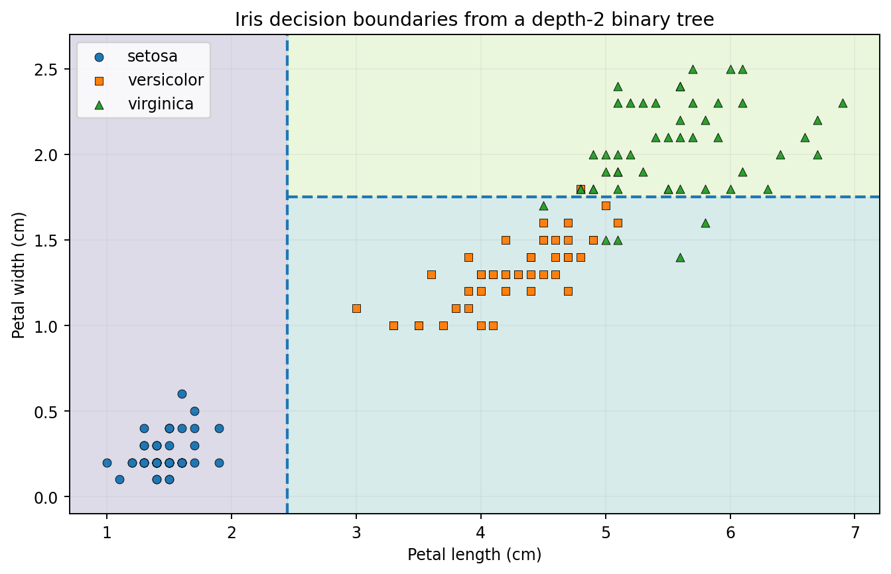
03 • IRIS CART • BUILD 1/2
Decision boundaries: first split
Depth 0 → first boundary
petal length ≤ 2.45 creates a vertical boundary because petal length is on the x-axis.
What happens?
Setosa is isolated on the left. The remaining region still mixes Versicolor and Virginica.

Slide 26
03 • IRIS CART • BUILD 2/2
Decision boundaries: second split
Depth 1 boundary
Inside the right-hand region, petal width ≤ 1.75 adds a horizontal boundary.
Key idea
A tree creates piecewise, axis-aligned regions. Each new split only affects the region that reached that node.
Decision-boundary concept mirrors the uploaded Hands-On ML excerpt, pp. 2–4

Slide 27
03 • IRIS CART
How does CART choose a split?
1. Try candidates
2. Measure impurity
3. Keep the best
Try a feature and threshold.
Example: petal length ≤ 2.35? 2.45? 2.55? …
Calculate the weighted impurity of the two children.
Choose the split that produces the lowest weighted child impurity.
Then recurse: repeat on each child using only the rows that reached that child.

Slide 28
03 • IRIS CART
CART is greedy
Greedy means
Why this matters
At each node, choose the best split available now.
It does not search every possible future tree to find a globally optimal tree.
Greedy training is practical and fast, but the locally best choice can still lead to a tree that is too complex or unstable.
This is one reason regularization becomes important.

Slide 29
03 • IRIS CART
Prediction = follow one path
New flower: petal length = 5.0 cm, petal width = 1.4 cm
petal length ≤ 2.45 ?
False
petal width ≤ 1.75 ?
True
Predict Versicolor
Inference is fast: evaluate only the questions along one root-to-leaf path.

Slide 30
TRY IT
Quick check: binary CART
1
At the root, samples = 150 means…
A. 150 features B. 150 training rows reached the node C. 150 leaves D. 150 classes
2
A node with gini = 0 is…
A. Pure B. Maximally mixed C. Pruned D. A regression node
3
If a new flower has petal length 5.0 and petal width 1.4, the shown tree predicts…
A. Setosa B. Versicolor C. Virginica D. Cannot predict
Answers: 1B • 2A • 3B

Slide 31
04
Regularization: control the tree
An unrestricted tree can keep splitting until it learns details that do not generalize.

Slide 32
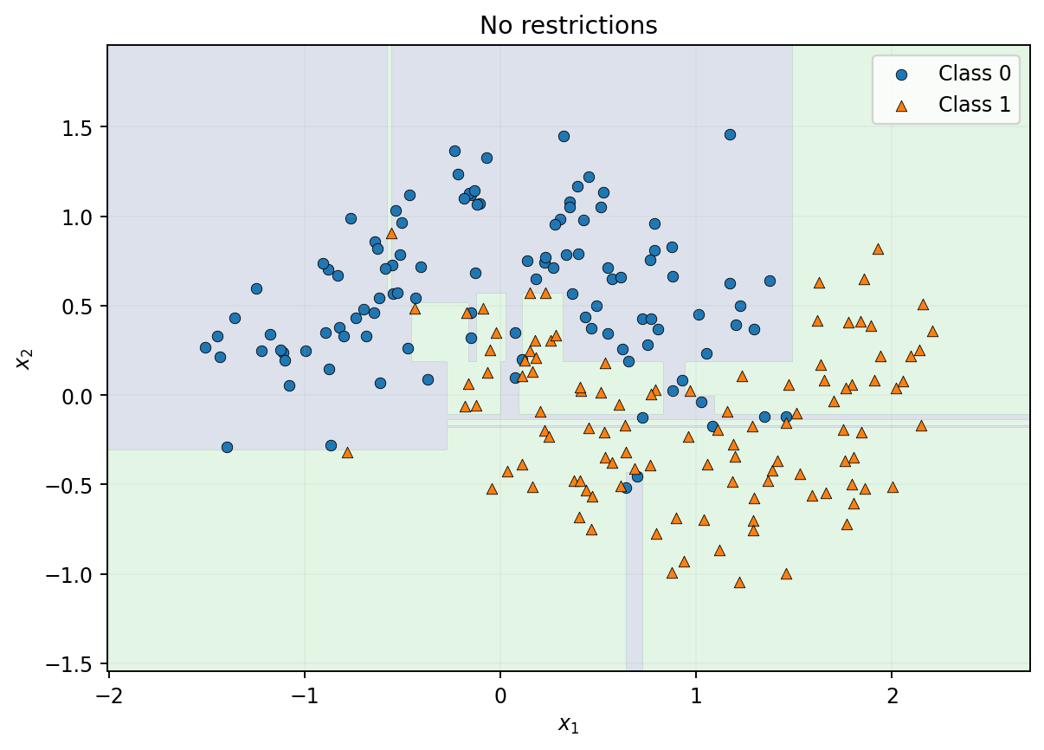
04 • REGULARIZATION
Unrestricted trees can overfit
What you see
A jagged decision boundary bends around individual training points.
Why it is risky
The model may be fitting noise or accidental details rather than a stable pattern.
Very low training error is not the same as good generalization.

Slide 33
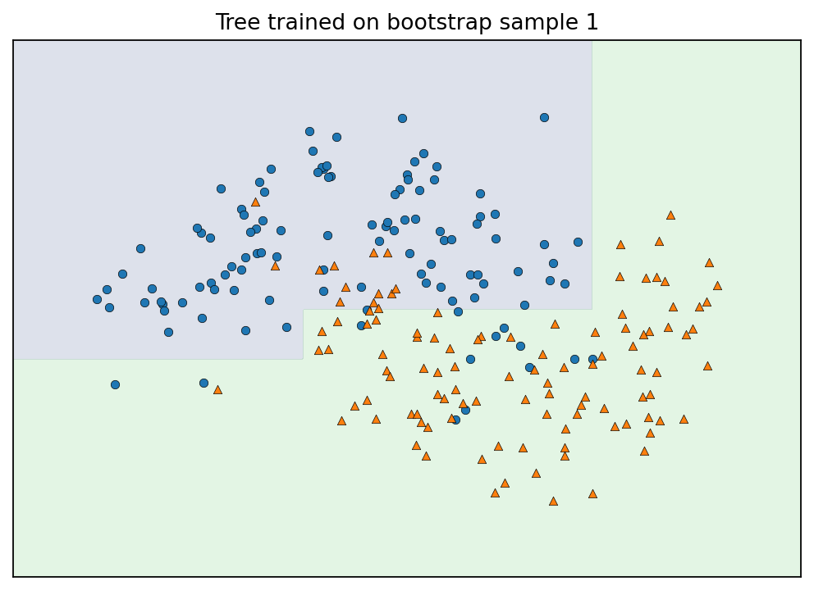
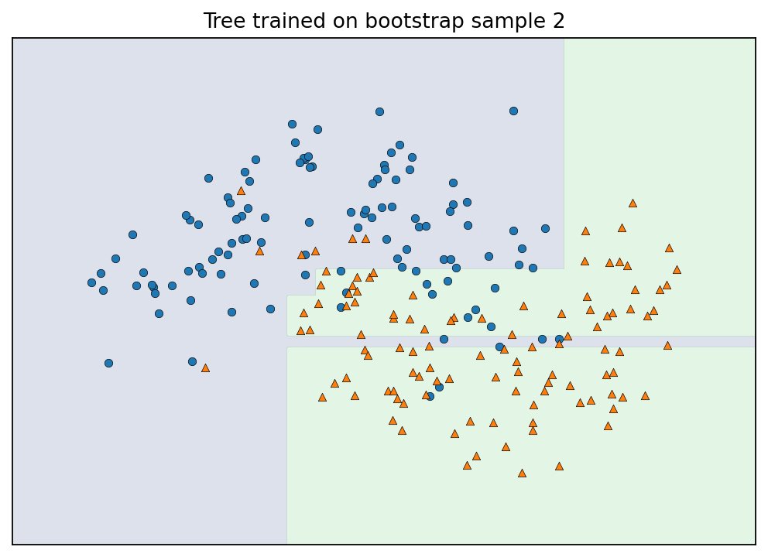
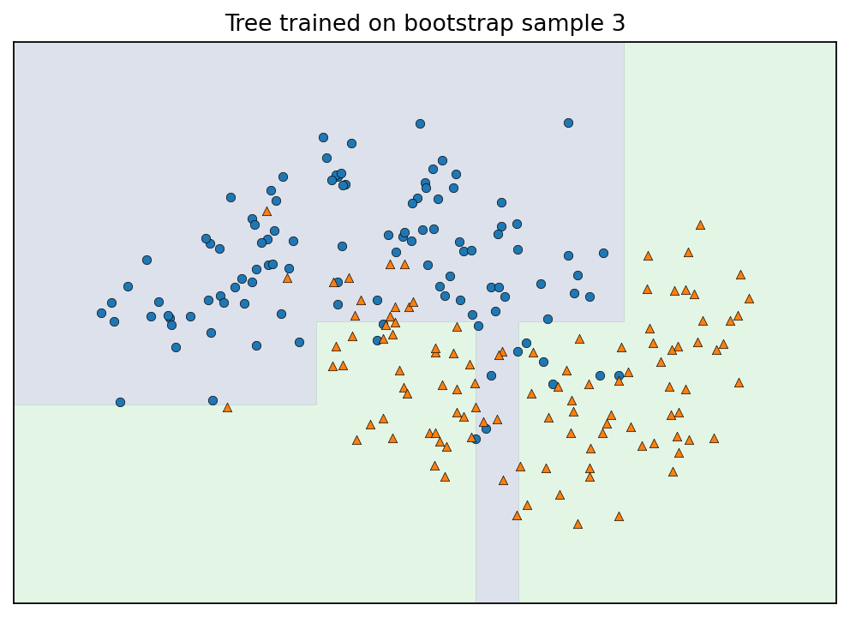
04 • REGULARIZATION • BUILD
High variance: small data changes, noticeably different trees
Same underlying problem. Different bootstrap samples. Different boundaries.
This sensitivity is what we mean when we say a decision tree can have high variance.

Slide 34
04 • REGULARIZATION
Regularization = deliberately limit flexibility
Without regularization
With regularization
Goal
Grow until very small, highly specific regions appear.
Risk: low bias, high variance.
Stop or restrict splitting before the tree becomes too detailed.
Trade a little training fit for a simpler model that is more stable on new data.
Regularization does not guarantee a better model—it controls capacity.

Slide 35
04 • REGULARIZATION
Control 1: max_depth
Depth 0
Intuition
max_depth limits how many questions a prediction path may contain.
Smaller depth → simpler rules
Larger depth → more detailed regions
Depth 1
Depth 1
Depth 2
Depth 2
STOP HERE when max_depth = 2
A shallow tree cannot memorize as many small pockets of the training set.

Slide 36
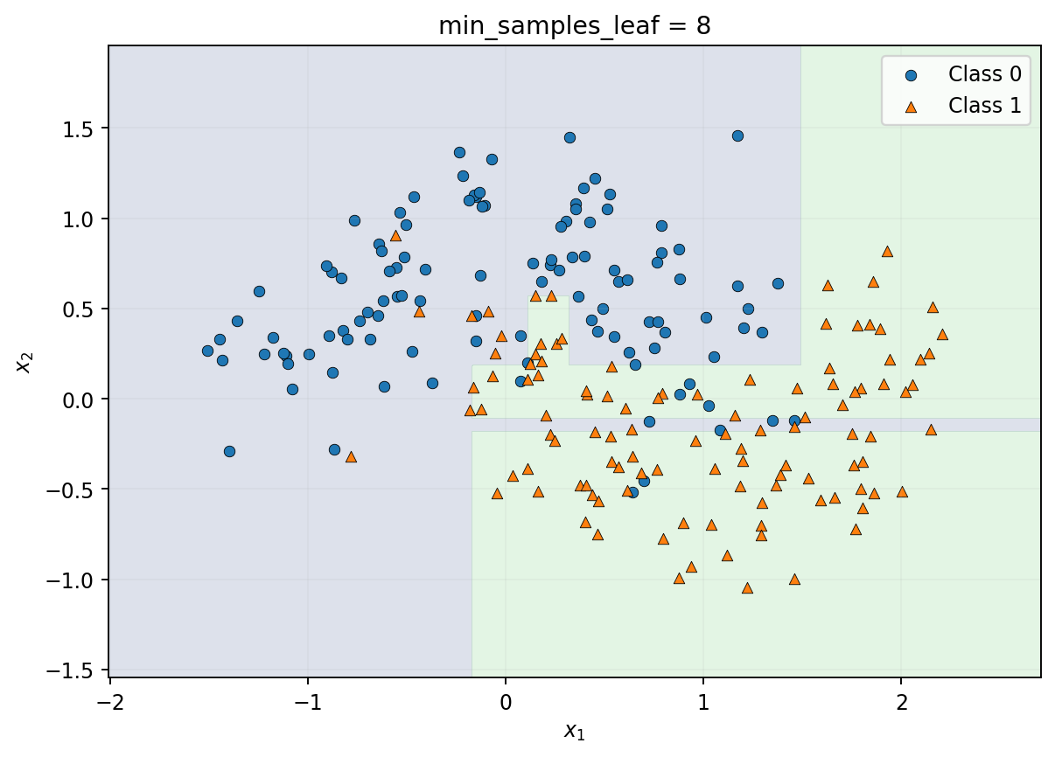
04 • REGULARIZATION
Control 2: min_samples_leaf
Rule
A split is allowed only if every resulting leaf contains at least the required number of training samples.
Effect
Tiny regions become harder to create. The boundary becomes smoother and less sensitive to individual points.
Increasing min_samples_leaf is a direct way to say: “do not make a leaf for only a few examples.”

Slide 37
04 • REGULARIZATION
Control 3: min_samples_split
Node contains 8 samples
Possible child
Possible child
If min_samples_split = 10
Intuition
This 8-sample node is not allowed to split at all.
Do not keep asking new questions when too little evidence remains in the node.

Slide 38
04 • REGULARIZATION
Other useful complexity controls
max_leaf_nodes
max_features
min_weight_fraction_leaf
ccp_alpha
Limit the total number of terminal regions the tree can create.
At a split, consider only some features rather than all features.
Require a minimum weighted fraction of samples in each leaf.
Cost-complexity pruning: penalize extra tree complexity after growth.
Regularization controls align with the uploaded Hands-On ML excerpt, p. 5

Slide 39
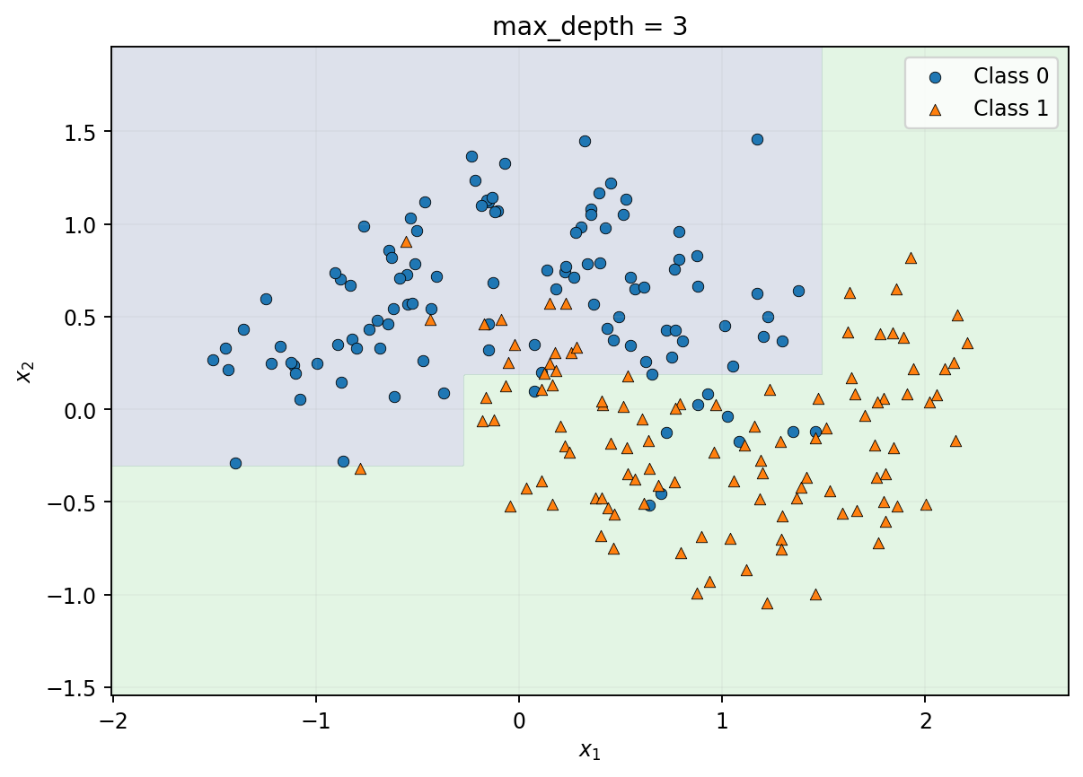
04 • REGULARIZATION
Same data: unrestricted vs. regularized
Unrestricted
max_depth = 3
The regularized tree accepts a simpler boundary to reduce sensitivity to training noise.

Slide 40
04 • REGULARIZATION
Regularization is a bias–variance tradeoff
More flexible
More constrained
lower training bias
higher variance
higher training bias
lower variance
Model selection
Use validation or cross-validation to choose an appropriate complexity.

Slide 41
TRY IT
Quick check: regularization
1
Which change usually makes a tree simpler?
A. Increase max_depth B. Decrease min_samples_leaf C. Decrease max_depth D. Add more leaves
2
A leaf containing only 1–2 samples is most directly discouraged by…
A. Larger min_samples_leaf B. Larger max_depth C. More classes D. One-hot encoding
3
An unrestricted tree has perfect training accuracy. What can we conclude?
A. It must generalize perfectly B. It may still overfit C. It has low variance D. It needs feature scaling
Answers: 1C • 2A • 3B

Slide 42
05
High variance → Ensemble Learning
Instead of trusting one unstable tree, combine many trees that make different errors.

Slide 43
05 • ENSEMBLES
Why many models can beat one model
Tree 1
Yes
Tree 2
No
Tree 3
Yes
Tree 4
Yes
Tree 5
No
Majority vote
YES (3 of 5)
Ensembles work best when individual models are reasonably useful and do not all make the same mistakes.

Slide 44
05 • ENSEMBLES
Bagging: same algorithm, different training samples
Bootstrap sample 1
Bootstrap sample 2
Bootstrap sample 3
Tree 1
Tree 2
Tree 3
Combine
vote / average
Bagging primarily reduces variance by averaging many high-variance learners.

Slide 45
05 • ENSEMBLES • BUILD 1/2
Bootstrap sampling: draw, replace, repeat
Original training rows
Sample with replacement
A
B
C
D
A
C
C
D
Key point
Why do this?
A row may appear more than once. Some original rows may not appear in a particular bootstrap sample.
Different samples make the trained trees different, which helps their errors cancel when combined.

Slide 46
05 • ENSEMBLES • BUILD 2/2
Different bootstrap samples → different trees
A C C D
B B A C
D A D B
Tree 1
Tree 2
Tree 3
Majority vote
The labels are not changed. Only which training rows each tree sees is changed.

Slide 47
05 • ENSEMBLES
Random forest = bagging + random feature candidates
1. Random rows
2. Random features
3. Best eligible split
Each tree receives a bootstrap sample of the training data.
At each split, consider only a random subset of available features.
Among those sampled features, choose the best split.
Feature randomness makes trees less similar, which can further reduce ensemble variance.
Random-row and random-feature framing follows the uploaded lecture deck, slides 31–43

Slide 48
05 • ENSEMBLES
Random forest prediction: everyone votes
Tree 1: Virginica
Tree 2: Versicolor
Tree 3: Virginica
Tree 4: Virginica
Tree 5: Versicolor
Tree 6: Virginica
Tree 7: Virginica
Final forest prediction
Virginica • 5 of 7 votes
Classification: vote. Regression: average the numeric predictions.

Slide 49
05 • ENSEMBLES
One tree, bagging, or random forest?
Method | Rows per tree | Features at split | Combine
Decision tree | All training rows | All eligible features | One tree
Bagging | Bootstrap sample | All eligible features | Vote / average
Random forest | Bootstrap sample | Random subset | Vote / average
1
What does bagging change between trees?
A. Target labels B. Bootstrap training rows C. Loss function D. Class names
2
What extra randomness does a random forest add?
A. Random class labels B. Random feature candidates at each split C. Random test set D. Random target
3
Why is this useful for high-variance trees?
A. Makes every tree identical B. Encourages diverse errors that can average out C. Removes all bias D. Guarantees 100% accuracy

Slide 50
EXIT TICKET
The whole lecture in five ideas
1
Engineer meaningful features
Give the model useful, honest information.
2
Know the tree structure
Multiway: many branches; CART: binary yes/no splits.
3
Read a CART tree
Threshold → impurity → samples → class counts → prediction.
4
Regularize high-variance trees
Limit depth, leaf size, or overall complexity.
5
Ensemble when one tree is unstable
Bagging and random forests combine diverse trees.
Final question: if a tree changes a lot when the training data changes a little, what problem do we have and what is one remedy?

Slide 51
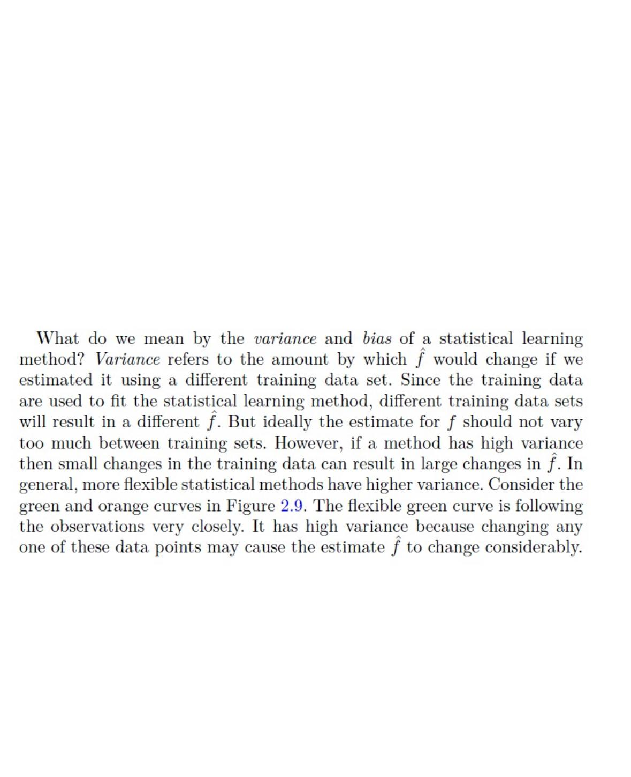

Slide 52
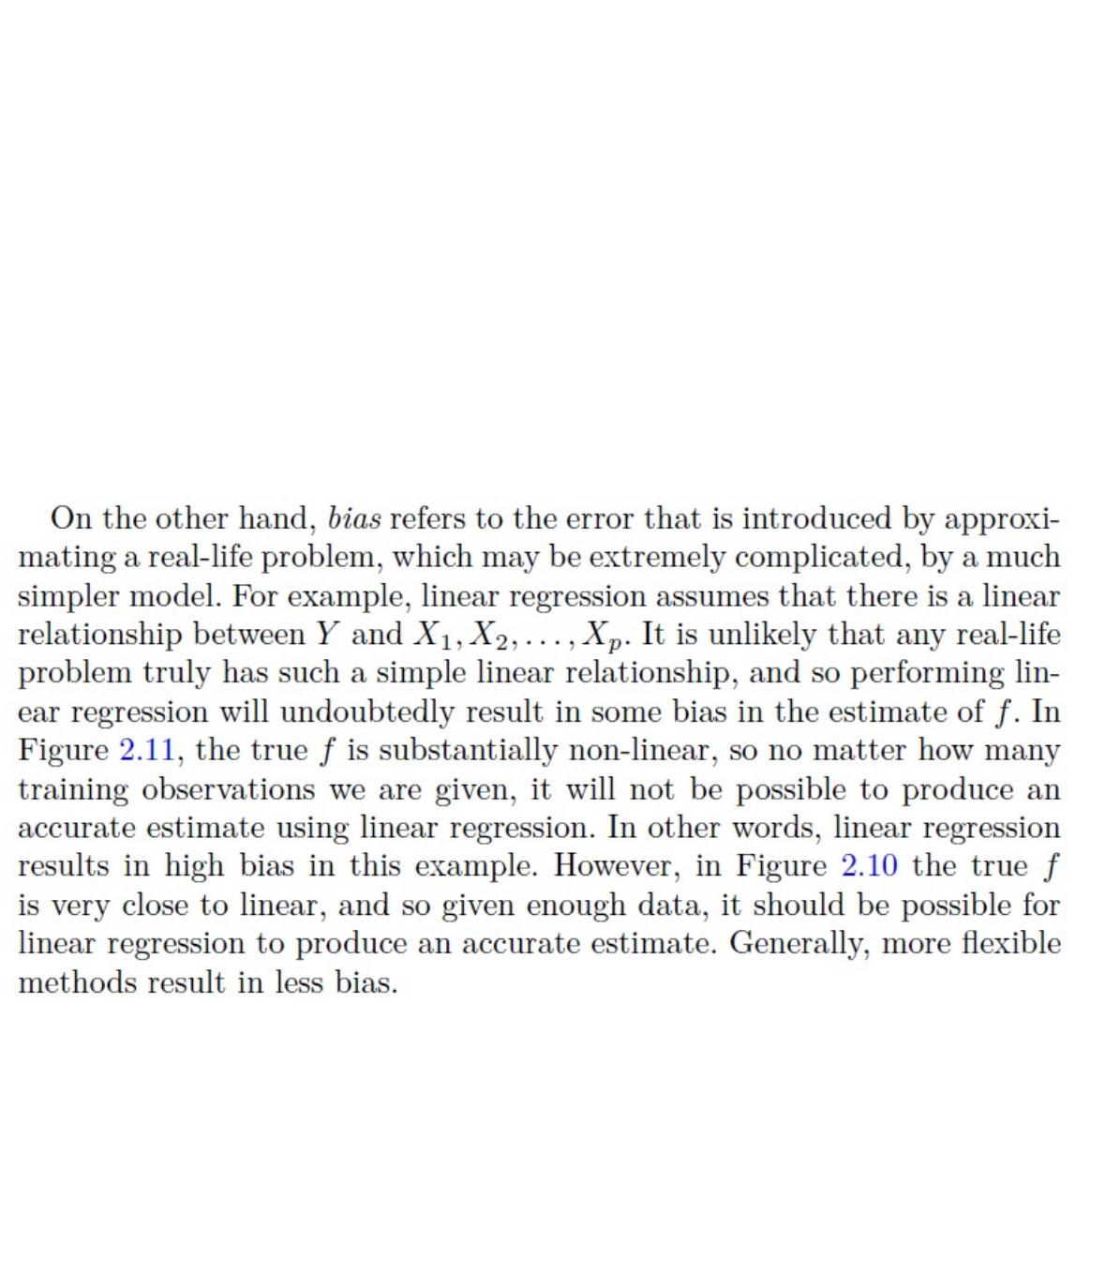

Slide 53
04 • REGULARIZATION
Other useful complexity controls
max_leaf_nodes
max_features
min_weight_fraction_leaf
ccp_alpha
Limit the total number of terminal regions the tree can create.
At a split, consider only some features rather than all features.
Require a minimum weighted fraction of samples in each leaf.
Some samples can count more because they have larger weights.
Cost-complexity pruning: penalize extra tree complexity after growth.
How expensive do we consider adding more branches and leaves?

Slide 54
EXAMPLE 1 • MIN_WEIGHT_FRACTION_LEAF
Equal weights: it behaves like a minimum leaf size
10 training samples, each with weight = 1
Total weight = 10
min_weight_fraction_leaf = 0.20
Minimum leaf weight = 0.20 × 10 = 2
Leaf A
Leaf B
Leaf C
3 samples
Weight = 3
2 samples
Weight = 2
1 sample
Weight = 1
✓ Allowed
✓ Allowed
✕ Not allowed
KEY IDEA
With equal weights, a 20% threshold means each leaf needs at least 20% of the total sample weight.

Slide 55
EXAMPLE 2 • MIN_WEIGHT_FRACTION_LEAF
Some samples count more than others
8 normal samples have weight = 1. Two important samples have weight = 3.
Total weight = 8(1) + 2(3) = 14
20% of 14 = 2.8 minimum
Leaf A
Leaf B
Leaf C
3 normal samples
Weight = 3
2 normal samples
Weight = 2
1 important sample
Weight = 3
✓ Allowed
✕ Not allowed
✓ Allowed
KEY IDEA
The rule uses total weight, not simply the number of samples in the leaf.

Slide 56
EXAMPLE 3 • MIN_WEIGHT_FRACTION_LEAF
Fraud detection: rare cases can receive more weight
NORMAL TRANSACTIONS
FRAUD TRANSACTION
5 normal transactions
weight = 1 each
1 fraud transaction
weight = 5
Total leaf weight = 5
Total leaf weight = 5
Same weighted importance
KEY IDEA
Weighted leaves are useful when rare or important examples should influence the tree more strongly.

Slide 57
EXAMPLE 1 • CCP_ALPHA
How expensive is an extra leaf?
Cost-complexity pruning grows the tree, then removes branches that are not worth their complexity.
Cost = Tree Error + α × Number of Leaves
Small ccp_alpha
Large ccp_alpha
Complexity is cheap → keep more branches
Complexity is expensive → prune more branches
KEY IDEA
Think of α as the price we pay for adding another leaf.

Slide 58
EXAMPLE 2 • CCP_ALPHA
Small α: the more complex tree can win
Compare two candidate trees using α = 0.5
TREE A
TREE B ✓
Error = 10
Leaves = 3
Cost = 10 + 0.5(3) = 11.5
Error = 7
Leaves = 6
Cost = 7 + 0.5(6) = 10
KEY IDEA
Because α is small, the three extra leaves are worth keeping when they reduce error enough.

Slide 59
EXAMPLE 3 • CCP_ALPHA
Large α: the simpler tree can win
Use the same trees, but now α = 2
TREE A ✓
TREE B
Error = 10
Leaves = 3
Cost = 10 + 2(3) = 16
Error = 7
Leaves = 6
Cost = 7 + 2(6) = 19
KEY IDEA
Higher ccp_alpha → more pruning → simpler tree → stronger regularization.

Slide 60
08 • ENSEMBLE LEARNING
Ensemble Learning: Many Models, One Decision
Instead of trusting one model, combine several models.
Combine
Final Prediction
Model 1
Model 2
Model 3
more stable & accurate
Core idea: different models make different mistakes — combining them can reduce error.
Dr. Abdelrahman Elfikky • UA Little Rock
Decision Trees & Ensembles
8

Slide 61
09 • ENSEMBLE LEARNING
Bagging: Train Models in Parallel
Bagging
Same dataset → different sampled datasets
• Create several bootstrap samples from the training data.
Sample 1
Sample 2
Sample 3
• Train one model on each sample independently.
with replacement
with replacement
with replacement
• Combine predictions by voting or averaging.
Tree
1
Tree
2
Tree
3
Vote /
Average
Main benefit: reduces variance and makes predictions more stable.
Dr. Abdelrahman Elfikky • UA Little Rock
Decision Trees & Ensembles
9

Slide 62
10 • ENSEMBLE LEARNING
Random Forest = Bagging + Random Features
1. Bootstrap Data
2. Random Features
3. Combine Trees
• Each decision tree receives a different sample of the training set.
• At each split, the tree considers only a random subset of features.
• Classification: majority vote.
• Regression: average prediction.
Why random features? → Trees become less similar to each other. Independent trees less correlated to each other. Wisdom of the crowd, more trustworthy than each single one.
Less correlation between trees → stronger ensemble.
Dr. Abdelrahman Elfikky • UA Little Rock
Decision Trees & Ensembles
10

Slide 63
11 • ENSEMBLE LEARNING
Boosting: Learn from Previous Mistakes
Unlike bagging, boosting trains models sequentially.
Model 1
Model 2
Model 3
Final
Initial
prediction
Focus on
errors
Correct more
errors
Combine all
models
Each new model pays more attention to what the previous models got wrong.
Main benefit: can reduce bias and build a very strong predictor from weak trees.
Dr. Abdelrahman Elfikky • UA Little Rock
Decision Trees & Ensembles
11

Slide 64
12 • ENSEMBLE LEARNING
XGBoost: Powerful Gradient-Boosted Trees
Boosted Trees
Gradient Idea
Why XGBoost?
• Build trees one after another.
• Use the loss function to determine what needs to be corrected next.
• Regularization helps control overfitting.
• Each new tree improves the current prediction.
• New trees move predictions in a better direction.
• Efficient implementation for tabular data.
• Widely used for strong predictive performance.
Simple view: Prediction = Tree 1 + small correction + small correction + …
Dr. Abdelrahman Elfikky • UA Little Rock
Decision Trees & Ensembles
12

Slide 65
13 • ENSEMBLE LEARNING
Bagging vs. Boosting — The Big Picture
Question
Bagging / Random Forest
Boosting / XGBoost
Training
Parallel
Sequential
Main idea
Average many different models
Correct previous mistakes
Typical tree
Many deep-ish trees
Many small / weak trees
Main effect
Reduce variance
Reduce bias; improve fit
Example
Random Forest
XGBoost
Remember: Random Forest is a bagging method; XGBoost is a boosting method.
Dr. Abdelrahman Elfikky • UA Little Rock
Decision Trees & Ensembles
13

